Slide 1
NOVAA Volunteer Management 301: Achieving Excellence!
Jim Laden
VP of Leadership and Talent
FoodCorps
j_laden@yahoo.com
March 15, 2018

Slide 2
Who
is in the
Room?

Slide 3
Think about an volunteer program that you have led, observed or participated in that achieved excellence in your opinion.
What were the characteristics of the program that resulted in the excellence?

Slide 4
Realizing the Mission
Meeting the Needs of Clients
Innovation
Excellent Use of Resources
Great Management
Volunteer Satisfaction
Staff Satisfaction
Organizational Development

Slide 5
Problem or Issue Identification
Organizational
Goal Setting
Program or Project Design
Program or Project Implementation
Program or Project Evaluation

Slide 6
Program or Project Planning
How will volunteers be involved?
What are the advantages of volunteers having roles?
How much agreement do you have among staff and
volunteer leaders?
How well does the plan reflect volunteer motivation and skills?
How do you close the gaps in motivation and skills?
How will you evaluate outcomes and make adjustments to meet the goals?

Slide 7
Case Study
An citywide organization that has built a stellar reputation for planting trees to restore urban tree cover has decided to expand through a program that builds vegetable gardens in people’s backyards and educates families about producing their own food.
Identify volunteer roles in the new program
Identify advantages of engaging volunteers in this program

Slide 8
Point - Counterpoint
Staff who see the Upsides | Volunteer Leaders who see the Upsides
Staff who see the Downsides | Volunteer Leaders who see the Downsides

Slide 9
Ideas Need Thorough Vetting
Multiple Perspectives are Important
Success Requires Support
Not Asking Could Create Trouble
Other Conclusions?

Slide 10
It’s Movie Time!

Slide 11
Digging into…
Mastery
Autonomy
Purpose

Slide 12
Developing Volunteers
Identify the Needs & Gaps
Plan the Outcomes & Content
Decide on a Best Approach
Implement the Plan
Provide Supervision or Coaching
Give Feedback

Slide 13
Johari Window
Open Self Information about you known to yourself and to others | Blind Self Information about you that you do not know but is known to others
Hidden Self Information about you that you know but others don’t know | Unknown Self Information about you that neither you nor others know

Slide 14
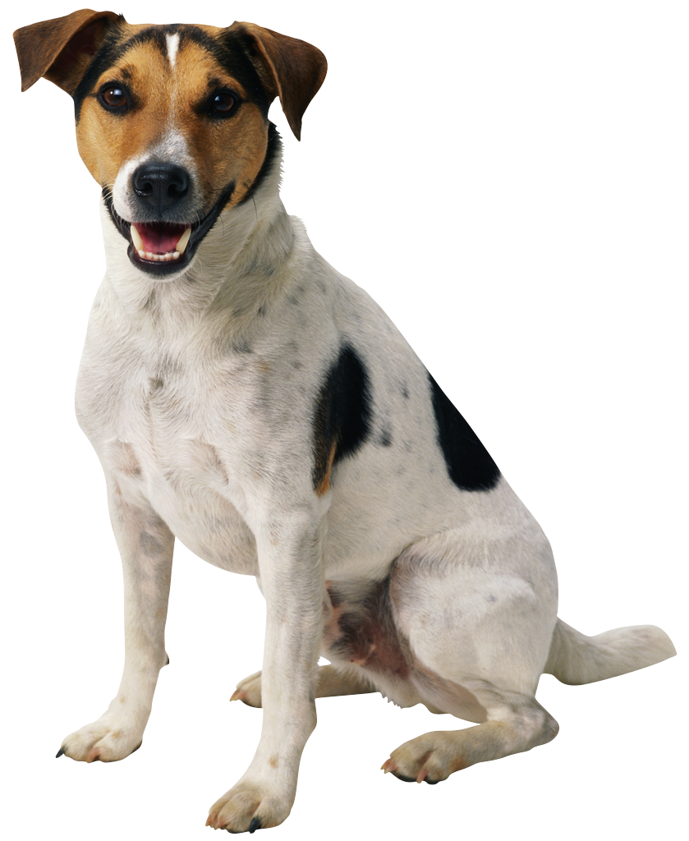
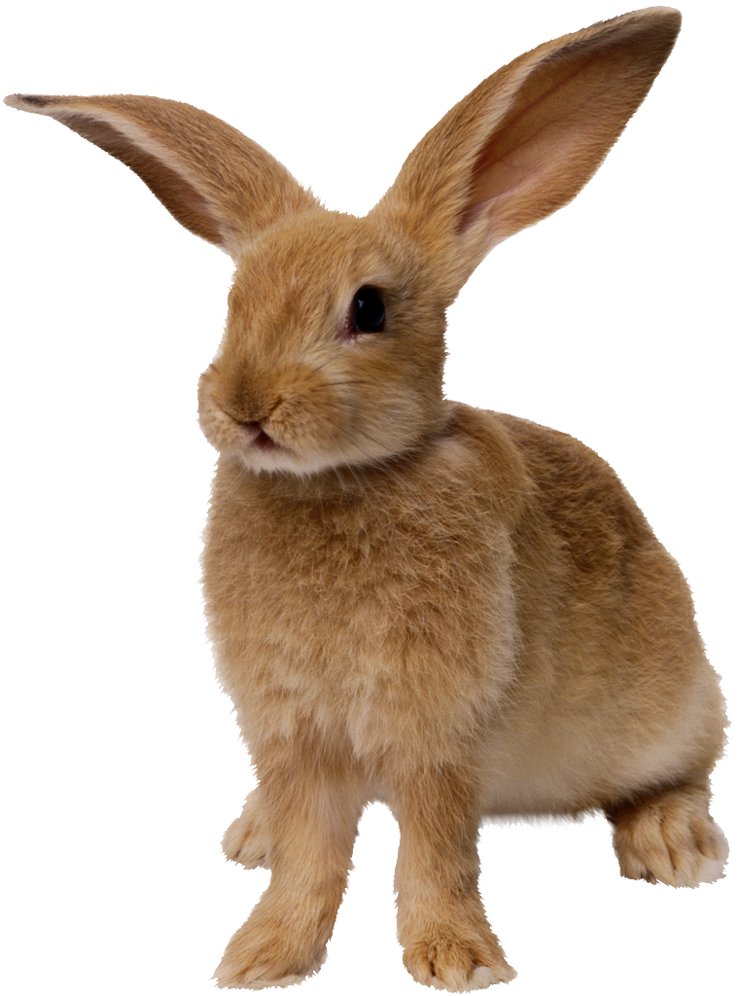
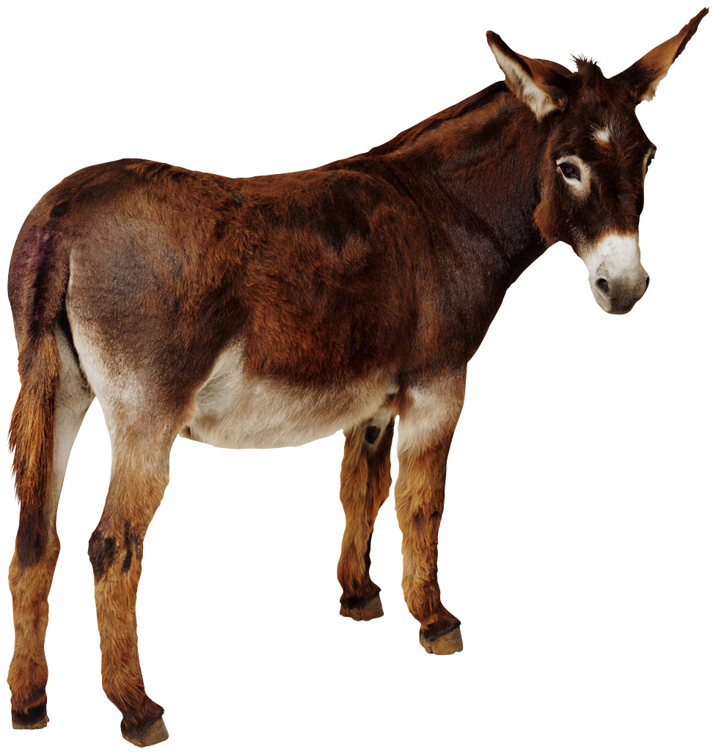
Channeling
Your
Spirit Animal

Slide 15
Giving Feedback Describe Observations Get Specific Balance the + and Δ Focus on 1-3 Things Be Timely Make it Actionable Consider Feelings Speak Genuinely Best when it follows self-assessment
Receiving Feedback
Assume Good Intent
Listen
Clarify to Understand
Identify Own Reactions
Breathe
Acknowledge Validity
Take Needed Time
Thank the Person
Best when it follows self-assessment

Slide 16
Methods of Evaluation
Needs What are the issues we wanted to address and how are the issues evolving? | Process How well is the delivery of the program working? How do stakeholders feel?
Outcome Is the program meeting the stated goals? | Impact Did the program affect the larger issues?

Slide 17
A Manager Made for Excellence

Slide 18
Questions and Comments

